Slide 1


EduTrust Foundation
Educational Trust Foundation for Sustainable Development

Slide 2
Leaders on “Education”
“Education is the most powerful weapon with which you can use to change the world.”
— Nelson Mandela

Slide 3



1 out of every 5 out-of-school children is in Nigeria.
More than 10.5 million children are out of the Nigerian education system and only 4% of girls in northern Nigeria complete secondary school.
Up to 50 million schoolchildren at all levels in Nigeria are deprived in one way or another.
Notes:
Notes to presenter:
What was important about this learning experience?
How is it relevant to your course, yourself, or your society or community?
Why is this significant?
This SmartArt allows you add images and text to help outline your process. If a picture is worth a thousand words, then pictures and words should help you communicate this reflection on learning perfectly! You can always click on Insert>SmartArt to change this graphic or select the graphic and click on the Design contextual menu to change the colors.

Slide 4
What?
Why?
How?
SDG-4:
Quality Education
http://www.un.org/sustainabledevelopment
Education is the key that will allow many other Sustainable Development Goals (SDGs) to be achieved
Empowers people
Break from poverty
Reduce inequalities
Gender equality
Healthy lives
Jobs and livelihoods
Peace and tolerance
National development
Notes:
Notes to presenter:
What was important about this learning experience?
How is it relevant to your course, yourself, or your society or community?
Why is this significant?
This SmartArt allows you add images and text to help outline your process. If a picture is worth a thousand words, then pictures and words should help you communicate this reflection on learning perfectly! You can always click on Insert>SmartArt to change this graphic or select the graphic and click on the Design contextual menu to change the colors.

Slide 5

EduTrust Foundation: Vision
A society in which access to quality education at all levels is equitably distributed and where the potentials of youth, learning and balanced development are unlocked.
Notes:
Notes to presenter:
Description of what you learned in your own words on one side.
Include information about the topic
Details about the topic will also be helpful here.
Tell the story of your learning experience. Just like a story there should always be a beginning, middle and an end.
On the other side, you can add a graphic that provides evidence of what you learned.
Feel free to use more than one slide to reflect upon your process. It also helps to add some video of your process.

Slide 6

EduTrust Foundation: Mission
To expand access to education in Nigeria by reaching students, communities and populations underserved and unserved by the formal schools sector in a bid to narrow the gap in human development and opportunities for advancement.
Notes:
Notes to presenter:
Description of what you learned in your own words on one side.
Include information about the topic
Details about the topic will also be helpful here.
Tell the story of your learning experience. Just like a story there should always be a beginning, middle and an end.
On the other side, you can add a graphic that provides evidence of what you learned.
Feel free to use more than one slide to reflect upon your process. It also helps to add some video of your process.

Slide 7

EduTrust Foundation: Core Values
Integrity
Innovation
Collaboration
Equity
Adaptation
Transparency
Notes:
Notes to presenter:
Description of what you learned in your own words on one side.
Include information about the topic
Details about the topic will also be helpful here.
Tell the story of your learning experience. Just like a story there should always be a beginning, middle and an end.
On the other side, you can add a graphic that provides evidence of what you learned.
Feel free to use more than one slide to reflect upon your process. It also helps to add some video of your process.

Slide 8
EduTrust Foundation: Objectives
Educational Resources
National Development
Sustainable Development
Job Creation
Notes:
Notes to presenter:
Description of what you learned in your own words on one side.
Include information about the topic
Details about the topic will also be helpful here.
Tell the story of your learning experience. Just like a story there should always be a beginning, middle and an end.
On the other side, you can add a graphic that provides evidence of what you learned.
Feel free to use more than one slide to reflect upon your process. It also helps to add some video of your process.

Slide 9

EduTrust Foundation: Our “Why?”
• The way schools’ curriculum is developed and the way our teaching and learning ecosystem is designed in Nigeria presently leave up to 50 million schoolchildren at all levels deprived.
• Those who have carved out an existence outside the formal schools sector are left behind, and those left behind will become a greater burden to society in the future.
Notes:
Notes to presenter:
What is your purpose for sharing this reflection?
Is it at the end of a unit or project?
Are you sharing this reflection, at the attainment of a learning goal you set for yourself?
Is it at the end of a course?
State your purpose for the reflection or even the purpose of the learning experience or learning goal. Be clear and be specific in stating your purpose.

Slide 10
EduTrust Foundation: Our “Why?”
• To meet this need will involve doing things differently and doing different things to make educational tools and products accessible, affordable, relatable and useable for all Nigerians.
• The government alone cannot meet this need; a variety of stakeholders are part of meeting the urgent needs of those underserved and unserved by the formal schools sector.
Notes:
Notes to presenter:
What is your purpose for sharing this reflection?
Is it at the end of a unit or project?
Are you sharing this reflection, at the attainment of a learning goal you set for yourself?
Is it at the end of a course?
State your purpose for the reflection or even the purpose of the learning experience or learning goal. Be clear and be specific in stating your purpose.

Slide 11
EduTrust Foundation: Our “Why?”
• Accelerated development towards achieving SDG-4 and the Nigeria Vision 20:2020 will be enhanced by supplementing the efforts of the government and not by supplanting it.
• Committed, responsive and responsible investments in education will have a ripple effect on development in all other sectors, including the family, quality of governance and nation building.
Notes:
Notes to presenter:
What is your purpose for sharing this reflection?
Is it at the end of a unit or project?
Are you sharing this reflection, at the attainment of a learning goal you set for yourself?
Is it at the end of a course?
State your purpose for the reflection or even the purpose of the learning experience or learning goal. Be clear and be specific in stating your purpose.

Slide 12


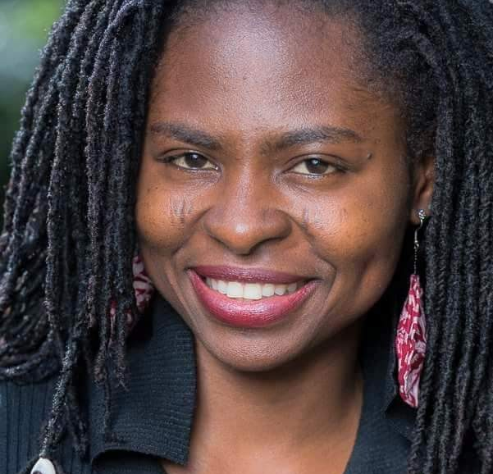

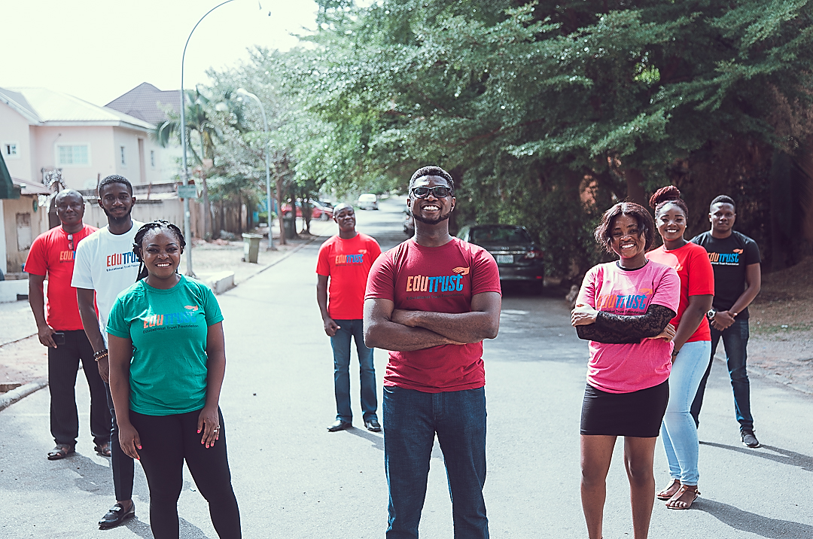

The EduTrust Team
Core team
Trustees
Network
Notes:
Notes to presenter:
Description of what you learned in your own words on one side.
Include information about the topic
Details about the topic will also be helpful here.
Tell the story of your learning experience. Just like a story there should always be a beginning, middle and an end.
On the other side, you can add a graphic that provides evidence of what you learned.
Feel free to use more than one slide to reflect upon your process. It also helps to add some video of your process.

Slide 13

EduTrust Foundation: Partnerships
Public Sector: Government MDAs at State and National levels
Private Sector: Educational Resource Providers, Publishers, ICT Firms
People Sector: Local NGO, CBOs, Communities, Traditional Institutions
Interest Groups: Schools, Student Unions, Teacher Unions
Development Partners: States, Agencies, INGOs, Foundations
Other Stakeholders: Individuals, Out-of-School Children and Youths
Notes:
Notes to presenter:
Description of what you learned in your own words on one side.
Include information about the topic
Details about the topic will also be helpful here.
Tell the story of your learning experience. Just like a story there should always be a beginning, middle and an end.
On the other side, you can add a graphic that provides evidence of what you learned.
Feel free to use more than one slide to reflect upon your process. It also helps to add some video of your process.

Slide 14
EduTrust Foundation: 5-Point Agenda
E-Schools Initiative
360° Advocacy
2
4
Capacity Development
1
3
Adopt-a-School
Job Creation
Notes:
Notes to presenter:
What steps will you be taking as a result of this learning experience?
Did you learn from any failed experiences? How will you do things differently?
What advice will you give to others so they can learn from your experiences?
How can you share what you learned with a real-world audience?
Some examples of next steps might be:
After delivering my first persuasive presentation, I am thinking about joining the debate team.
After making my first film, I’m considering entering it in our school film festival or local film festival.
After connecting with this career expert, I’d like to do some research on that career field because it sounds interesting to me.
This SmartArt allows you add images and text to help outline your process. If a picture is worth a thousand words, then pictures and words should help you communicate this reflection on learning perfectly! You can always click on Insert>SmartArt to change this graphic or select the graphic and click on the Design contextual menu to change the colors.
Feel free to use more than one slide to share your next steps. It also helps to add some video content to explain your message.

Slide 15

E-Schools Initiative: 5-Step Approach
Standardize
4
Localize
3
2
Gamify
1
Digitize
Disseminate
Notes:
Notes to presenter:
What steps will you be taking as a result of this learning experience?
Did you learn from any failed experiences? How will you do things differently?
What advice will you give to others so they can learn from your experiences?
How can you share what you learned with a real-world audience?
Some examples of next steps might be:
After delivering my first persuasive presentation, I am thinking about joining the debate team.
After making my first film, I’m considering entering it in our school film festival or local film festival.
After connecting with this career expert, I’d like to do some research on that career field because it sounds interesting to me.
This SmartArt allows you add images and text to help outline your process. If a picture is worth a thousand words, then pictures and words should help you communicate this reflection on learning perfectly! You can always click on Insert>SmartArt to change this graphic or select the graphic and click on the Design contextual menu to change the colors.
Feel free to use more than one slide to share your next steps. It also helps to add some video content to explain your message.

Slide 16
Leaders on “Education”
“The goal of education is not to increase the amount of knowledge but to create the possibilities for a child to invent and discover, to create men who are capable of doing new things.”
— Jean Piaget
“The highest education is that which does not merely give us information but makes our life in harmony with all existence.”
— Rabindranath Tagore

Slide 17




Thank You
@edutrustfoundation
+234 908 476 7777
info@edutrustfoundation.org.ng
www.edutrustfoundation.org.ng

